Slide 1
Data Warehousing and Data Mining

Slide 2
UNIT I

Slide 3
Topics to be covered
Basic Concepts
Data Ware House Modeling: Cube and OLAP
Data Ware House Design and Usage
Data Ware House Implementation

Slide 4
Basic Concepts

Slide 5
What is Data Warehouse??????
It is an emerging data repository architecture.
This is a repository of multiple heterogeneous data sources organized under a unified schema at a single site to facilitate management decision making.
“A data warehouse is a subject - oriented, integrated, time variant and non-volatile collection of data in support of management decision making process.”
These four keywords—subject-oriented, integrated, time-variant, and nonvolatile distinguish data warehouses from other data repository systems, such as relational database systems, transaction processing systems, and file systems.

Slide 6
Data Warehouse Properties
Subject
Oriented
Integrated
Data
Warehouse
Non Volatile
Time Variant

Slide 7
What is Data Warehouse??????
Subject-Oriented : Stored data according to target specific subjects.
Example : It may store data regarding total Sales, Number of Customers, etc. and not general data on everyday operations.
Integrated : Data may be distributed across heterogeneous sources which have to be integrated.
Example: Sales data may be on RDB, Customer information on Flat files, etc.
Time Variant : Data are stored to provide information from an historic perspective. Example: Data of sales in last 5 years, etc.
Non-Volatile : It is separate from the Enterprise Operational Database and hence is not subject to frequent modification. It generally has only 2 operations performed on it: Loading of data and Access of data.

Slide 8

Heterogeneous Information Sources
“Heterogeneities are everywhere”
Personal
Databases
World
Wide
Web
Scientific Databases
Digital Libraries
Different interfaces
Different data representations
Duplicate and inconsistent information

Slide 9
Features of a Warehouse…….
It is separate from Operational Database.
Integrates data from heterogeneous systems.
Stores HUGE amount of data, more historical than current data.
Does not require data to be highly accurate.
Queries are generally complex.
Goal is to execute statistical queries and provide results which can influence decision making in favor of the Enterprise.
These systems are thus called Online Analytical Processing Systems (OLAP).

Slide 10
Differences between Operational Database Systems and Data Warehouses
The major task of operational database systems is to perform online transaction and query processing. These systems are called Online Transaction Processing (OLTP) systems. It covers most of the day-to-day operations of an organization such as purchasing, inventory, manufacturing, banking, payroll, registration, and accounting.
Data warehouse systems, on the other hand, serve users or knowledge workers in the role of data analysis and decision making. These systems are known as online analytical processing (OLAP) systems.

Slide 11
 | Operational DB Systems | Data Warehouse Systems
Users | An OLTP system is customer-oriented and used by clerks, clients, and IT professionals. | An OLAP system is market-oriented and is used for data analysis by knowledge workers, including managers, executives, and analysts.
Data Contents | Current and detailed data and is subject to modifications. | Historical data generally not modified.
Database Design | Usually E-R model. (Application oriented Database Design) | Usually Multidimensional model (Star, Snowflake…). (Subject Oriented Database Design)
Access Pattern (Nature of Query) | OLTP systems mainly consist for Short and atomic transaction desiring high performance (less latency) and accuracy. It requires Concurrence Control and Recovery mechanisms. | Mostly read only queries, operate on HUGE volumes of data, queries are quite complex.
Database Size | In Gigabytes to higher order Gigabytes. | > = Terabytes or Petabytes.
View | Detailed | Summarized.

Slide 12
Need of a Separate Data Warehouse
OLTP systems require high Concurrency, Reliability, Locking which provide good performance for short and simple OLTP queries. An OLAP query is very complex and does not require these properties. Use of OLAP query on OLTP system degrades its performance.
OLAP systems access historical data and not current volatile data while OLTP systems access current up-to-date data and do not need historical data.
An operational database is designed for known tasks like indexing and hashing using primary keys, searching for particular records, and many more.
On the other hand, data warehouse queries are often complex. They involve the computation of large data groups at summarized levels, and may require the use of special data organization, access, and implementation methods based on multidimensional views.

Slide 13
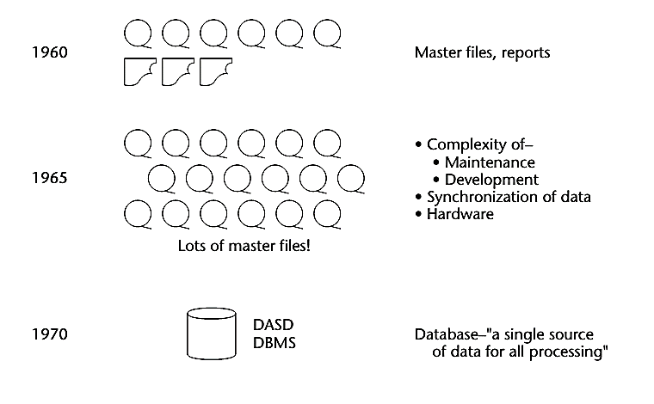
Origin/Evolution of Data Warehouse

Slide 14
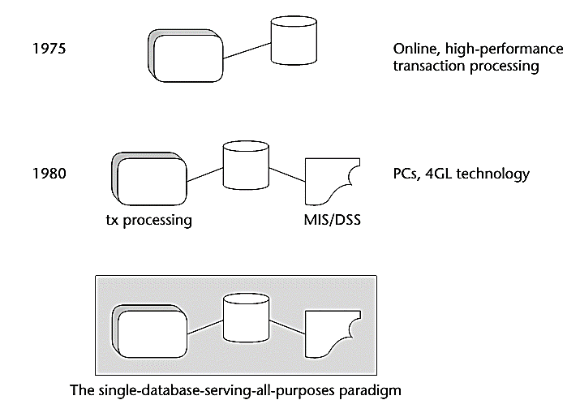

Slide 15
In the early 1960s, the world of computation consisted of creating individual applications that were run using master files, usually built in an early language such as Fortran or COBOL. The master files were housed on magnetic tape. The magnetic tapes were good for storing a large volume of data cheaply, but the drawback was that they had to be accessed sequentially.
Around the mid-1960s, the growth of master files and magnetic tape exploded. And with that growth came huge amounts of redundant data.
By 1970, the day of a new technology for the storage and access of data had dawned. The 1970s saw the advent of disk storage, or the direct access storage device (DASD). Disk storage was fundamentally different from magnetic tape storage in that data could be accessed directly on a DASD. There was no need to go through records 1, 2, 3, . . . N to get to record N + 1.
By the mid-1970s, online transaction processing (OLTP) made even faster access to data possible. The computer could now be used for tasks not previously possible, including driving reservations systems, bank teller systems, manufacturing control systems, and the like.
By the 1980s, more new technologies, such as PCs and fourth-generation languages (4GLs), began to surface.

Slide 16
Data warehouse modeling: cube and OLAP

Slide 17
OLAP (Online Analytical Processing)

Slide 18
Data Warehouse
A data warehouse is a subject-oriented, integrated, time-variant, and nonvolatile collection of data in support of management’s decision-making process.

Slide 19
Online Analytical Processing
An OLAP system manages large amount of historical data, provides facilities for summarization and aggregation, and stores and manages information at different levels of granularity.

Slide 20
Why Separate Data Warehouse?
High performance for both systems
DBMS— tuned for OLTP: access methods, indexing, concurrency control, recovery
Warehouse—tuned for OLAP: complex OLAP queries, multidimensional view, consolidation.
Different functions and different data:
missing data: Decision support requires historical data which operational DBs do not typically maintain
data consolidation: DS requires consolidation (aggregation, summarization) of data from heterogeneous sources
data quality: different sources typically use inconsistent data representations, codes and formats which have to be reconciled

Slide 21
From Tables and Spreadsheets to Data Cubes
A data warehouse is based on a multidimensional data model which views data in the form of a data cube.
A data cube, such as sales, allows data to be modeled and viewed in multiple dimensions
In data warehousing literature, an n-D base cube is called a base cuboid. The top most 0-D cuboid, which holds the highest-level of summarization, is called the apex cuboid. The lattice of cuboids forms a data cube.

Slide 22
OLTP vs. OLAP

Slide 23
OLAP Server Architectures
Relational OLAP (ROLAP):
Use relational or extended-relational DBMS to store and manage warehouse data and OLAP middle ware to support missing pieces.
Include optimization of DBMS backend, implementation of aggregation navigation logic, and additional tools and services
greater scalability
Multidimensional OLAP (MOLAP):
Array-based multidimensional storage engine (sparse matrix techniques)
fast indexing to pre-computed summarized data
Hybrid OLAP (HOLAP):
User flexibility, e.g., low level: relational, high-level: array.
Specialized SQL servers:
specialized support for SQL queries over star.snowflake schemas

Slide 24
Multidimensional Data
Sales volume as a function of product, month, and region
Dimensions: Product, Location, Time
Hierarchical summarization paths
Region
Industry Region Year
Category Country Quarter
Product City Month Week
Office Day
Product
Month

Slide 26
Typical OLAP Operations
Roll up (drill-up): summarize data
by climbing up hierarchy or by dimension reduction
Drill down (roll down): reverse of roll-up
from higher level summary to lower level summary or detailed data, or introducing new dimensions
Slice and dice:
project and select
Pivot (rotate):
reorient the cube, visualization, 3D to series of 2D planes.
Other operations
drill through: through the bottom level of the cube to its back-end relational tables (using SQL)

Slide 27
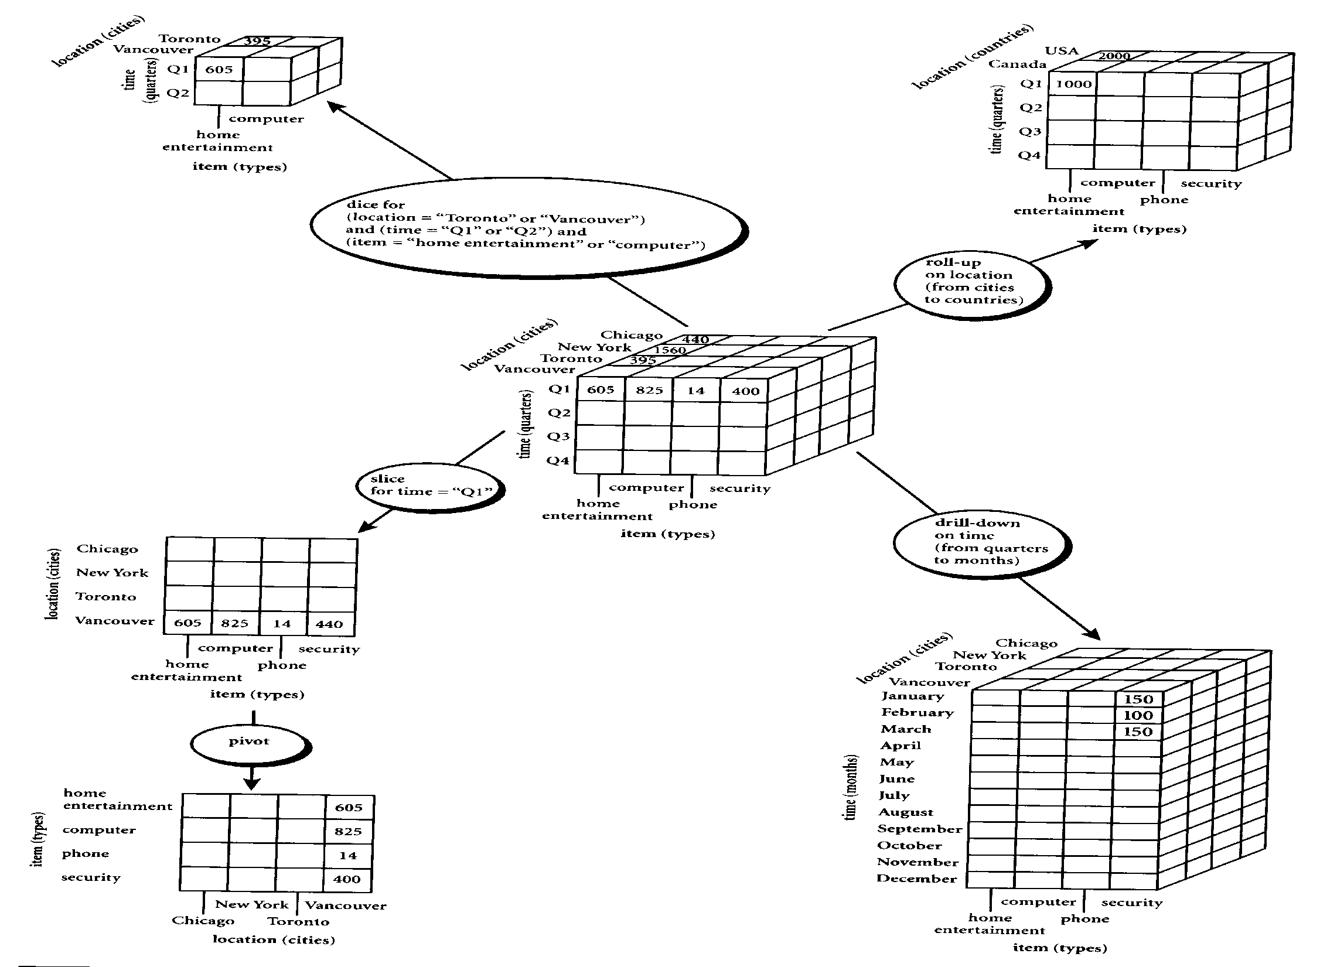

Slide 28
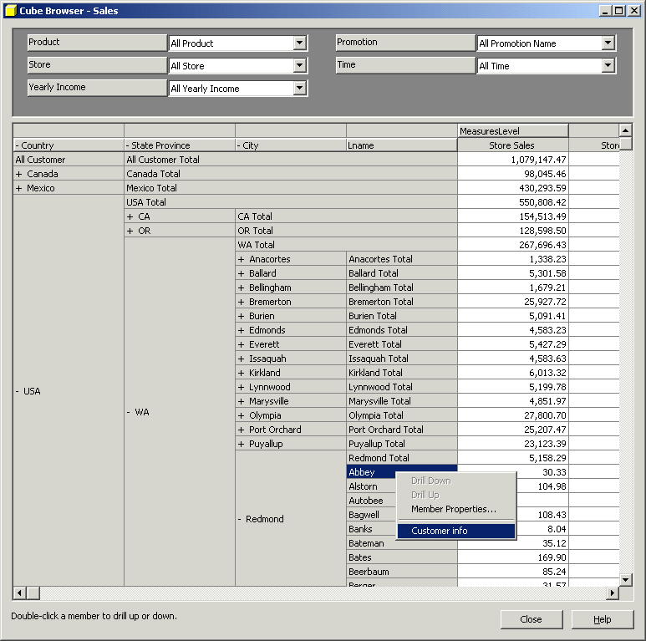
Sample OLAP Drill down online report

Slide 29
Cube Operation
Cube definition and computation in OLAP
define cube sales[item, city, year]: sum(sales_in_dollars)
compute cube sales
Transform it into a SQL-like language (with a new operator cube by)
SELECT item, city, year, SUM (amount)
FROM SALES
CUBE BY item, city, year
Need compute the following Group-Bys
(date, product, customer),
(date,product),(date, customer), (product, customer),
(date), (product), (customer)
()
()
(city)
(item)
(year)
(city, item)
(city, year)
(item, year)
(city, item, year)

Slide 30
Roll-up and Drill-down
The roll-up operation performs aggregation on a data cube, either by climbing up a concept hierarchy for a dimension or by dimension reduction such that one or more dimensions are removed from the given cube.
Drill-down is the reverse of roll-up. It navigates from less detailed data to more detailed data. Drill-down can be realized by either stepping down a concept hierarchy for a dimension or introducing additional dimensions.

Slide 31
Slice and dice
The slice operation performs a selection on one dimension of the given cube, resulting in a sub_cube.
The dice operation defines a sub_cube by performing a selection on two or more dimensions.

Slide 36
Querying with MDX (Multidimensional Expressions)
The select clause defines axis dimensions on COLUMNS and on ROWS, where clause supplies slicer dimensions, and Cube is the name of the data cube.
Select axis [, axis]
From Cube
Where slicer [, slicer]

Slide 37
The Data Hierarchy
For the majority of MDX statements, the context of the query will be limited to a single cube. It is important to know how all data within a cube is divided into the following relationship:
Dimensions
Hierarchies
Levels
Members

Slide 38
Sample MDX where italic are default
SELECT
{[Gender].[Gender].Members} ON COLUMNS,
{[Product].[Product Family].Members} ON ROWS,
FROM [Sales]
WHERE
([Measures].[Unit Sales],
[Customers].[All Customers],
[Education Level].[All Education Level],
[Marital Status].[All Martial status],
[Promotions].[All Promotions],
[Store].[All Stores],
[Store Size in SQFT].[All],
[Store Type].[All],
[Yearly Income].[All Yearly Income]

Slide 39
Example on Star Schema

Slide 40
Example on Roll-up
MDX
SELECT [SALES].[AMOUNT] ON COLUMNS,
[store].[Kowloon] ON ROWS
FROM SALES
SQL
select sum(amount), area
from SALES
where (area='Kowloon') group by area

Slide 41
Graphical Description on Roll-up Example
Roll-up
on Store Dimension
(from store to area)
Store is the child of Area

Slide 42
Example on Drill-down
MDX
SELECT [SALES].[AMOUNT] ON COLUMNS,
[time].[2003].[Q4].[Dec].[31],
[time].[2003].[Q4].[Dec].[30],… …,
[time].[2003].[Q4].[Dec].[2],
[time].[2003].[Q4].[Dec].[1] ON ROWS FROM SALES
SQL
select sum(amount), the_date
from SALES
where (the_date='2003-Dec-31')
or (the_date='2003-Dec-30')
or… …or (the_date='2003-Dec-2')
or (the_date='2003-Dec-1') group by the_date

Slide 43
Graphical Description of Drill-down Example
Drill-down
on Time Dimension
(from month to date)
Month is the parent of Date

Slide 44
Example on Slice
MDX
SELECT [SALES].[AMOUNT] ON COLUMNS,
[store].[Kowloon].[292] ON ROWS FROM SALES
SQL
select sum(amount), storecode
from SALES
where (storecode='292') group by storecode

Slide 45
Graphical Description of Slice
Slice
WHERE store = ‘292’

Slide 46
Example on Dice
MDX
SELECT [SALES].[AMOUNT] ON COLUMNS,
[store].[HK],[store].[NT], [store].[Kowloon] ON ROWS
FROM SALES WHERE [time].[2003].[Q4].[Dec].[24]
SQL
select sum(amount), area
from SALES
where ( (area='HK') or (area='NT') or (area='Kowloon'))
and (the_date='2003-Dec-24')
group by area

Slide 47
Graphical Description of Dice
Dice
WHERE (store = ‘292’) and (time = ‘Dec’) and product = ‘ALL’

Slide 48
The CrossJoin ( ) Function
The CrossJoin ( ) function is used to generate the cross-product of two input sets. If two sets exist in two independent dimensions, the CrossJoin operator creates a new set consisting of all of the combinations of the members in the two dimensions.

Slide 49
Filter ( ) Versus Slicer
In some respects, the Filter ( ) function and the slicer axis have similar purposes. The difference between the two is that the Filter ( ) function defines the members in a set, while slicers determine a slice of the cube returned from a query.

Slide 50
The Order ( ) Function
The Order ( ) function provides sorting capabilities within the MDX language. When the Order expression is used, it can either sort within the natural hierarchy (ASC and BDESC), or it can sort without the hierarchy (BASC and BDESC). The “B” indicates “break” hierachy.

Slide 51
TopCount ( ) and BottomCount ( ) Functions
The TopCount () and BottomCount() functions provide rank functionality critical in a decision support and data analysis environment. These expressions sort a set based on a numerical expression and pick the top index items based on rank order.

Slide 52
Sales Data Warehouse Star Schema of the SalesRecord

Slide 53
Sample Star Schema of Sales Record
Dimension tables:
[Gender].[Gender Members]
[Product].[Product Name]
[Marital Status].[All Martial status]
[Promotions].[All Promotions],
[Store].[All Stores],
[Store Size in SQFT].[All],
[Store Type].[All],
[Yearly Income].[All Yearly Income]
[Time].[Year]
Fact table:
[Measures].[Unit Sales],
[Measures].[Store Cost],
[Measures].[Store Sales],
[Measures].[Sales Count],
[Measures].[Store Sales Net]

Slide 54
Axis Dimensions in the Select Clause
Select
CrossJoin({[Gender]. [Gender]. Members},
{[Time].[Year]. Members}) ON COLUMNS,
{[Measures].Members} ON ROWS
FROM [Sales]
Where CrossJoin operator of source sets creates a new set consisting of all of the combinations of the members of the source sets.

Slide 55
This query crossjoins the Gender and the Time dimensions to produce data in which the data for each gender is broken into two years in this cube.
The two specific sets that are within the CrossJoin are the two members of the gender level of the Gender dimension, and the two years in the year level of the Time dimension.
The set of all members of the Measure dimension is included on the rows axis.
There is no member explicitly added as a slicer in this query.

Slide 56
Output from the data cube of Slicer Function
F
M
 | 1997 | 1998 | 1997 | 1998
Unit Sales | 131,558.00 |  | 135,215.00
Store Cost | 111,777.48 |  | 113,849.75
Store Sales | 280,228.21 |  | 285,011.92
Sales count | 428.31 |  | 440.06
Store Sales Net | 168,448.73 |  | 171,162.17

Slide 57
Filter filers a set based on a particular condition
SELECT
{[Measures]. [Unit Sales]} ON COLUMNS,
{Filter({[Product]. [Product Department].Members},
([Gender]. [All Gender].[F],[Measures].[Unit Sales]) > 10000)} ON ROWS
FROM [Sales]

Slide 58
The Filter function produces a set of product departments meeting the Filter criteria
The results of this query show that the set returned on the rows axis consists of product departments for which unit sales to females is greater than $10000

Slide 59
Output from the data cube
 | Unit Sales
Frozen Food | 26,655.00
Produce | 37,792.00
Snack Foods | 30,545.00
Household | 27,038.00

Slide 60
TopCount( ) and BottomCount( ) Functions
SELECT
{[Customers].[All Customers].[USA],
[Customers].[All Customers].[USA].Children}ON COLUMNS,
{TopCount({[Product].[Product Category].Members},
5, [Measures].[Unit Sales]),
BottomCount({[Product].[Product Category].Members},
5, [Measures].[Unit Sales])} ON ROWS
FROM [Sales]
Where TopCount is to request the highest count of the data as a result of the query. Similarly, BottomCount is to request the lowest count of the data as a result of the query.

Slide 61
The columns axis contains the members from the customers dimension. The single member, {[Customers].[All Customers].[USA] is specified and the children of USA, [Customers].[All Customers].[USA]. Children, are combined in a comma- separated list to make up the set.
The product categories are included on the rows axis in a comma-separated list where different operators are used to specify a particular subset of the [Product].[Product Category]. Members set. Unit sales is used as the measure with which to select the top five product categories and the bottom five product categories.

Slide 62
Output from the data cube
 | USA | CA | OR | WA
Snack Foods | 30,545.00 | 8,543.00 | 7,789.00 | 14,213.00
Vegetables | 20,733.00 | 5,506.00 | 5,447.00 | 9,306.00
Dairy | 12,885.00 | 3,534.00 | 3,131.00 | 6,220.00
Jams & Jelies | 11,888.00 | 3,343.00 | 2,877.00 | 5,868.00
Fruit | 11,767.00 | 3,184.00 | 3,008.00 | 5,575.00
Canned Oysters | 708.00 | 220.00 | 182.00 | 296.00
Canned Shimp | 804.00 | 231.00 | 173.00 | 400.00
Hardware | 810.00 | 281.00 | 215.00 | 334.00
Candies | 815.00 | 286.00 | 248.00 | 303.00
Canned Food | 819.00 | 234.00 | 215.00 | 370.00

Slide 63
The Order () Function
Select
{[Marital Status].[All Marital Status].[S]} ON COLUMNS,
{Order ({[Promotion Media].[Media Type].Members},
[Unit Sales], BDESC)} ON ROWS
FROM [Sales]
Where BDESC means sort descending without hierarchy.

Slide 64
The Order function provides sorting capabilities within the MDX language in ASC, DESC, BASC and BDESC where “B” indicates “break” hierarchy.
The sort was performed using the [Marital Status] .[All Marital Status].[S] member in descending order without hierarchy of the unit sales.

Slide 65
Output from the data cube
Marital Status | S
No Media | 95.970.00
Daily Paper, Radio, TV | 4,787.00
Daily Paper | 3,559.00
Product Attachment | 3,352.00
Daily Paper, Radio | 3,572.00
Cash Register Handout | 3,567.00
Sunday Paper, Radio | 3,285.00
Street Handout | 2,921.00
Sunday Paper | 2,098.00
Bulk Mail | 2,271.00
In Store Coupon | 1,829.00
TV | 1,873.00
Sunday Paper, Radio, TV | 1,378.00
Radio | 1,298.00

Slide 66
Filter Function
Select
{[Gender], Members} ON COLUMNS,
{TopCount ({[Product].[Product Name].Members},10,
([Gender].[Gender].[F], [Measures].[Unit Sales]))} ON ROWS
FROM [Sales]
WHERE ([Marital Status].[All Marital Status].[M],
[Measures].[Unit Sales])

Slide 67
This query is motivated by a desire to determine which products married women are most likely to purchase and the sales of these same products to married men.
The columns axis contains all members of the gender dimension, [All Gender], [F]. and [M]. [All Gender] is included because the .Members function was placed on the gender dimension instead of on the [Gender].[Gender] level.
The fundamental set in the rows axis consists of names of products (members of the [Product].[Product Name] level). In this query the TopCount ( ) function is used to examine some of the products. Of specific interest here are the top 10 products in unit sales pruchased by females. Therefore, the index in the TopCount ( ) function is 10, and the numeric expression is the tuple ([Gender].[Gender].[F], [Measures].[Unit Sales]).
The slicer contains the two members explicitly defined, [Marital Status].[All Marital Status].[M] and [Measures].[Unit Sales], because only data with these characteristics is desired.

Slide 68
Output from the data cube
 | All Gender | F | M
Fabulous Berry Juice | 127.00 | 87.00 | 40.00
Fast Beef Jerky | 134.00 | 87.00 | 47.00
BBB Best Pepper | 134.00 | 82.00 | 52.00
Ebony Cantelope | 130.00 | 80.00 | 50.00
Peart Cheable Wine | 117.00 | 79.00 | 38.00
Skinner Diel Cola | 115.00 | 78.00 | 37.00
Shdy Lake Manicotti | 106.00 | 78.00 | 28.00
Pearl Light Beer | 130.00 | 77.00 | 53.00
Shady Lake Rice Medly | 131.00 | 77.00 | 54.00
TriState Potatos | 108.00 | 76.00 | 32.00

Slide 69
Example of OLAP
Starting with the base cuboid [Year, Month, Customer, Product, Sales-person, Sales-quota, Actual-sales], what specific OLAP operation should be performed in order to list the total Actual Sales by Customer in year 2000?
The requested SQL statement is:
Select Customer, Sum(Actual_sales) From Sales Where year = ‘2000’ Group by customer
The requested MDX statement is:
Select{[Sales].Actual_sales}on Columns
({[Customer].Customer_name},{[Time].Year}) on Rows
from Cuboid
Where ([Time].[Year].[2000])

Slide 70
Tutorial Question 5
Suppose that a data warehouse consists of the three dimensions time, doctor, and patent, and the two measures count and charge, where charge is the fee that a doctor charges a patient for a visit. Starting with the base cuboid [day, doctor, patient], provide a MDX (Multidimensional Expression) query to list the total fee collected by each doctor in 2000?
To obtain the same list, write an SQL query assuming the data is stored in a relational database with the table fee (day, month, year, doctor, hospital, patient, count, charge).
Starting with the base cuboid [day, doctor, patient], provide a MDX (Multidimensional Expression) query to list the total fee collected by each doctor in 2000?
To obtain the same list, write an SQL query assuming the data is stored in a relational database with the table fee (day, month, year, doctor, hospital, patient, count, charge).

Slide 71
Data warehouse design and usage

Slide 72
Data Warehouse Usage

Slide 73
Introduction
Data warehouses and data marts are used in a wide range of applications.
Business executives use the data in data warehouses and data marts to perform data analysis and make strategic decisions.
Data warehouses are used extensively in banking and financial services, consumer goods and retail distribution sectors, and controlled manufacturing such as demand-based production.

Slide 74
Introduction
Initially, the data warehouse is mainly used for generating reports and answering predefined queries.
Progressively, it is used to analyze summarized and detailed data, where the results are presented in the form of reports and charts.
Later, the data warehouse is used for strategic purposes, performing multidimensional analysis and sophisticated slice-and-dice operations.
Finally, the data warehouse may be employed for knowledge discovery and strategic decision making using data mining tools.

Slide 75
Data Warehouse Applications
There are three kinds of data warehouse applications:
information processing,
analytical processing, and
data mining.

Slide 76
Data Warehouse Applications
Information processing
supports querying, basic statistical analysis, and reporting using crosstabs, tables, charts and graphs
Analytical processing
It generally operates on historic data in both summarized and detailed forms.
supports basic OLAP operations, slice-dice, drilling, pivoting.
The major strength of online analytical processing over information processing is the multidimensional data analysis of data warehouse data.
Data mining
knowledge discovery from hidden patterns
supports associations, constructing analytical models, performing classification and prediction, and presenting the mining results using visualization tools

Slide 77
“How does data mining relate to information processing and online analytical processing? ”
Information processing, based on queries, can find useful information. However, answers to such queries reflect the information directly stored in databases or computable by aggregate functions.
It do not reflect hidden patterns or regularities buried in the database.
Therefore, information processing is not data mining.

Slide 78
“Do OLAP systems perform data mining? Are OLAP systems actually data mining systems?”
The functionalities of OLAP and data mining can be viewed as disjoint.
OLAP is a data summarization/aggregation tool that helps simplify data analysis.
Data mining allows the automated discovery of implicit patterns and interesting knowledge hidden in large amounts of data.
OLAP functions are essentially for user-directed data summarization and comparison.
Data mining covers a much broader spectrum than simple OLAP operations, because it performs not only data summarization and comparison but also association, classification, prediction, clustering, time-series analysis, and other data analysis tasks.

Slide 79
Data mining is not confined to the analysis of data stored in data warehouses.
It may also analyze transactional, spatial, textual, and multimedia data that are difficult to model with current multidimensional database technology.

Slide 80
From Online Analytical Processing to Multidimensional Data Mining
Multidimensional data mining (also known as exploratory multidimensional data mining, online analytical mining, or OLAM) integrates OLAP with data mining to uncover knowledge in multidimensional databases.
Among the many different paradigms and architectures of data mining systems, multidimensional data mining is particularly important for the following reasons:

Slide 81
From Online Analytical Processing to Multidimensional Data Mining
High quality of data in data warehouses:
Most data mining tools need to work on integrated, consistent, and cleaned data, which requires costly data cleaning, data integration, and data transformation as preprocessing steps.
A data warehouse constructed by such preprocessing serves as a valuable source of high-quality data for OLAP as well as for data mining.

Slide 82
From Online Analytical Processing to Multidimensional Data Mining
Available information processing infrastructure surrounding data warehouses:
Comprehensive information processing and data analysis infrastructures have been or will be systematically constructed surrounding data warehouses, which include accessing, integration, consolidation, and transformation of multiple heterogeneous databases, ODBC/OLEDB connections, Web accessing and service facilities, and reporting and OLAP analysis tools.
It is prudent to make the best use of the available infrastructures rather than constructing everything from scratch.

Slide 83
From Online Analytical Processing to Multidimensional Data Mining
OLAP-based exploration of multidimensional data:
Effective data mining needs exploratory data analysis. A user will often want to traverse through a database, select portions of relevant data, analyze them at different granularities, and present knowledge/results in different forms.
Online selection of data mining functions:
Users may not always know the specific kinds of knowledge they want to mine. By integrating OLAP with various data mining functions, multidimensional data mining provides users with the flexibility to select desired data mining functions and swap data mining tasks dynamically.

Slide 84
Data warehouse implementation

Slide 85
Data Warehouse Implementation
Data warehouses contain huge volumes of data.
OLAP servers demand that decision support queries be answered in the order of seconds.
Therefore, it is crucial for data warehouse systems to support highly efficient cube computation techniques, access methods, and query processing techniques.

Slide 86
Efficient Data Cube Computation
One approach to cube computation extends SQL so as to include a compute cube operator.
The compute cube operator computes aggregates over all subsets of the dimensions specified in the operation.
This can require excessive storage space, especially for large numbers of dimensions.

Slide 87

EXAMPLE

Slide 88
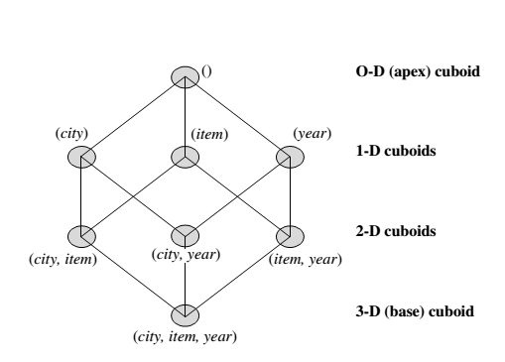
EXAMPLE
If we start at the apex cuboid and explore downward in the lattice, this is equivalent to drilling down within the data cube. If we start at the base cuboid and explore upward,
this is akin to rolling up.

Slide 89
An SQL query containing no group-by (e.g., “compute the sum of total sales”) is a zero dimensional operation.
An SQL query containing one group-by (e.g., “compute the sum of sales, group-by city ”) is a one-dimensional operation.
A cube operator on n dimensions is equivalent to a collection of group-by statements, one for each subset of the n dimensions.

Slide 90
Similar to the SQL syntax, the data cube can be defined as:
define cube sales_cube [city, item, year]: sum(sales_in_dollars)
A statement such as
compute cube sales_cube
would explicitly instruct the system to compute the sales aggregate cuboids for all eight subsets of the set {city, item, year }, including the empty subset.

Slide 91
Transform it into a SQL-like language (with a new operator cube by, introduced by Gray et al.’96)
SELECT item, city, year, SUM (amount)
FROM SALES
CUBE BY item, city, year

Slide 92

“How many cuboids are there in an n-dimensional data cube ???”

Slide 93


“How many cuboids are there in an n-dimensional data cube ???”

Slide 94
By now, you probably realize that it is unrealistic to pre-compute and materialize all of the cuboids that can possibly be generated for a data cube.
If there are many cuboids, and these cuboids are large in size.
A more reasonable option is partial materialization; that is, to materialize only some of the possible cuboids that can be generated.

Slide 95
Partial Materialization: Selected Computation of Cuboids
There are three choices for data cube materialization given a base cuboid:
No materialization: Do not pre-compute any of the “non-base” cuboids. This leads to computing expensive multidimensional aggregates on-the-fly, which can be extremely slow.
Full materialization: Pre-compute all of the cuboids. It is referred to as the full cube. It requires huge amounts of memory space in order to store all of the pre-computed cuboids.

Slide 96
Partial Materialization: Selected Computation of Cuboids
Partial materialization: We may compute a subset of the cube, which contains only those cells that satisfy some user-specified criterion. It is also referred to as sub-cube.

Slide 97
Indexing OLAP Data: Bitmap Index and Join Index
To facilitate efficient data accessing, most data warehouse systems support index structures and materialized views (using cuboids).
Bitmap indexes have traditionally been considered to work well for data such as gender, which has a small number of distinct values, for example male and female, but many occurrences of those values.

Slide 98
Bitmap Index
The bitmap indexing method is popular in OLAP because it allows quick searching in data cubes.
If a given attribute’s domain consists of n values, then n bits are needed for each entry in the bitmap index (i.e., there are n bit vectors).
If the attribute has the value v for a given row in the data table, then the bit representing that value is set to 1 in the corresponding row of the bitmap index. All other bits for that row are set to 0.

Slide 99
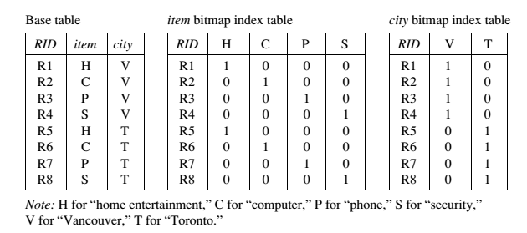
Bitmap Index

Slide 100
Bitmap Index Facts
Bitmap indexing is advantageous compared to hash and tree indices.
It is especially useful for low-cardinality domains.
Bitmap indexing leads to significant reductions in space and input/output (I/O) since a string of characters can be represented by a single bit.
For higher-cardinality domains, the method can be adapted using compression techniques.

Slide 101
join indexing
Traditional indexing maps the value in a given column to a list of rows having that value.
Join indexing registers the joinable rows of two relations from a relational database.
Join indexing is especially useful for maintaining the relationship between a foreign key and its matching primary keys, from the joinable relation.
Join index: JI(R-id, S-id) where R (R-id, …)  S (S-id, …)

Slide 102
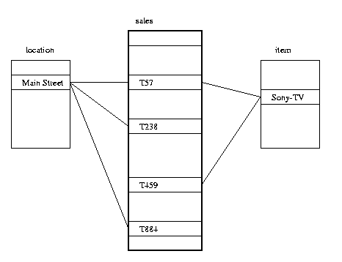
join indexing
In data warehouses, join index relates the values of the dimensions of a star schema to rows in the fact table.
E.g. fact table: Sales and two dimensions city and product.
Join indices can span multiple dimensions.

Slide 103
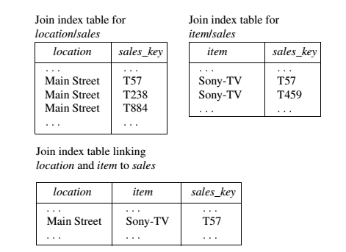
Example

Slide 104
Efficient Processing of OLAP Queries
The purpose of materializing cuboids and constructing OLAP index structures is to speed up query processing in data cubes. Given materialized views, query processing should proceed as follows:
Determine which operations should be performed on the available cuboids.
Determine to which materialized cuboid(s) the relevant operatiozns should be applied.

Slide 105
example
Suppose that we define a data cube for AllElectronics of the form “sales cube [time, item, location]: sum(sales in dollars).”
The dimension hierarchies used are
“day < month < quarter < year ” for time ;
“item name < brand < type ” for item;
“street < city < province or state < country ” for location.

Slide 106
Suppose that the query to be processed is on {brand, province_or_ state}, with the selection constant “year = 2010.” Also, suppose that there are four materialized cuboids available, as follows:
cuboid 1: {year, item_name, city}
cuboid 2: {year, brand, country }
cuboid 3: {year, brand, province_or_state}
cuboid 4: {item_name, province_or_state }, where year = 2010
“Which of these four cuboids should be selected to process the query?”

Slide 107
result
Finer-granularity data cannot be generated from coarser-granularity data.
Therefore, cuboid 2 cannot be used because country is a more general concept than province or state.
Cuboids 1, 3, and 4 can be used to process the query

Slide 108
“How would the costs of each cuboid compare if used to process the query?”

Slide 109
UNIT II

Slide 110
Topics to be covered
Basic Concepts of data Mining
Different types of data repositories
Data mining Functionalities
Concepts of interesting patterns
Data Mining tasks
Current Trends
Major issues and ethics in data mining

Slide 111
Basic concepts of Data mining

Slide 112
What is Data Mining??????
It is also known as Knowledge Discovery from Data (KDD).
We live in a world where vast amounts of data are collected daily. Analyzing such data is an important need.
“We are living in the information age” is a popular saying; however, we are actually “living in the data age”.
This explosive growth of available data volume is a result of the computerization of our society and the fast development of powerful data collection and storage tools.

Slide 113
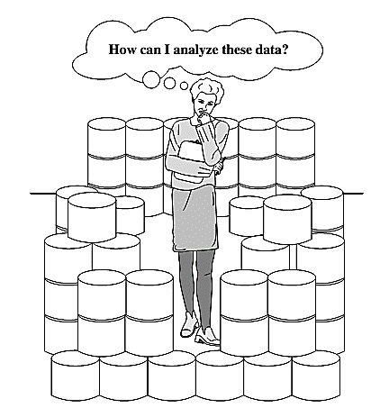
The world is data rich but information poor

Slide 114


Slide 115
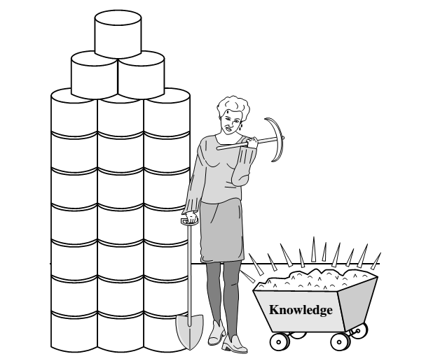
Data collected in large data repositories become “data tombs”. The data mining tools that can turn data tombs into “golden nuggets” of knowledge. Golden nuggets means “small but valuable facts”.
Data mining is also called as knowledge mining from data, knowledge extraction, data/pattern analysis, data archaeology, and data dredging.

Slide 116
The knowledge discovery process
It is an iterative sequence of the following steps:
Data cleaning (to remove noise and inconsistent data)
Data integration (where multiple data sources may be combined)
Data selection (where data relevant to the analysis task are retrieved from the database)
Data transformation (where data are transformed and consolidated into forms appropriate for mining by performing summary or aggregation operations)
Data mining (an essential process where intelligent methods are applied to extract data patterns)
Pattern evaluation (to identify the truly interesting patterns representing knowledge based on interestingness measures)
Knowledge presentation (where visualization and knowledge representation techniques are used to present mined knowledge to users)

Slide 117
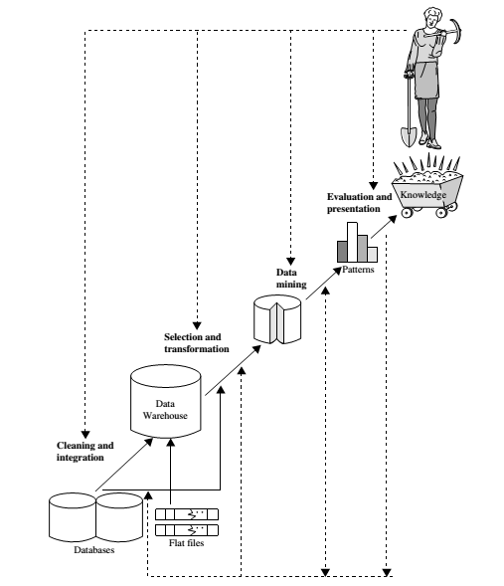

Slide 118
Data Mining functionalities

Slide 119
Data Mining Functionalities
Data mining functionalities are used to specify the kinds of patterns to be found in data mining tasks.
Class/Concept Description: Characterization and Discrimination:
Data entries can be associated with classes or concepts.
For example, in the AllElectronics store, classes of items for sale include computers and printers, and concepts of customers include bigSpenders and budgetSpenders. Such descriptions of a class or a concept are called class/concept descriptions.

Slide 120
Data characterization
It is a summarization of the general characteristics or features of a target class of data.
The data corresponding to the user-specified class are typically collected by a query.
For example, to study the characteristics of software products with sales that increased by 10% in the previous year, the data related to such products can be collected by executing an SQL query on the sales database.
There are several methods for effective data summarization or characterization. The data cube-based OLAP roll-up operation can be used to perform user-controlled data summarization along a specified dimension.
The output of data characterization can be presented in various forms. Examples include pie charts, bar charts, curves, multidimensional data cubes, and multidimensional tables, including crosstabs.

Slide 121
Data discrimination
Data discrimination is a comparison of the general features of the target class data objects against the general features of objects from one or multiple contrasting classes.
The target and contrasting classes can be specified by a user, and the corresponding data objects can be retrieved through database queries.
For example, a user may want to compare the general features of software products with sales that increased by 10% last year against those with sales that decreased by at least 30% during the same period.

Slide 122
concept of interesting patterns

Slide 123
Mining Frequent Patterns
Frequent patterns, as the name suggests, are patterns that occur frequently in data.
There are many kinds of frequent patterns, including item-sets, and subsequences.
A frequent item-set typically refers to a set of items that frequently appear together in a transactional data set, such as milk and bread, which are frequently bought together in grocery stores by many customers.
Mining frequent patterns leads to the discovery of interesting associations and correlations within data.

Slide 124

Association analysis
Where X is a variable representing a customer.
A confidence, or certainty, of 50% means that if a customer buys a computer, there is a 50% chance that he/she will buy software as well.
A 1% support means that 1% of all the transactions under analysis show that computer and software are purchased together.

Slide 125
Classification and Regression for Predictive Analysis
Classification is the process of finding a model (or function) that describes and distinguishes data classes or concepts.
Eg : male or female
The derived model is based on the analysis of a set of training data (i.e., data objects for which the class labels are known).
The model is used to predict the class label of objects for which the class label is unknown.
Regression analysis is a statistical methodology that is most often used for numeric prediction, although other methods exist as well.

Slide 126
“How is the derived model presented?”
The derived model may be represented in various forms, such as classification (IF-THEN) rules, decision trees, mathematical formulae, or neural networks

Slide 127
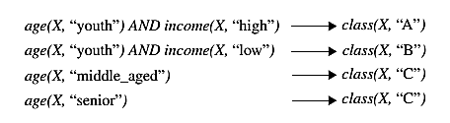
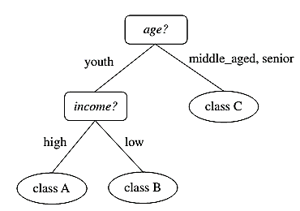
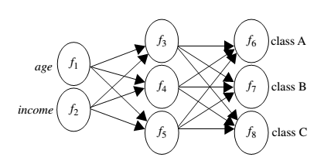
IF - THEN Rules
Decision Tree
Neural Net

Slide 128
Cluster analysis
Unlike classification and prediction, which analyze class-labeled data objects, clustering analyzes data objects without consulting a known class label.
In general, the class labels are not present in the training data simply because they are not known to begin with. Clustering can be used to generate such labels.
The objects are clustered or grouped based on the principle of
“maximizing the intra-class similarity and minimizing the interclass similarity”
That is, clusters of objects are formed so that objects within a cluster have high similarity in comparison to one another, but are rather dissimilar to objects in other clusters.

Slide 129
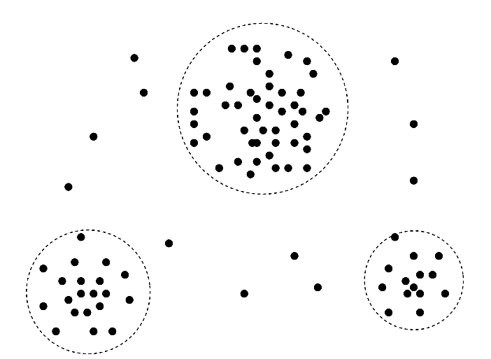

Slide 130
Outlier Analysis
Data objects that do not match with the general behavior or model of the data. Most analysis discard outliers as noise or exceptions.
Outliers may be detected using statistical tests, or using distance measures where objects that are a substantial distance from any other cluster are considered outliers.
Example: outlier analysis may uncover fraudulent usage of credit cards by detecting purchases of extremely large amounts for a given account number in comparison to regular charges incurred by the same account

Slide 131
Are All Patterns Interesting?
Only a small fraction of the patterns potentially generated would actually be of interest to any given user.
a pattern is interesting if it is:
easily understood by humans
valid on new or test data with some degree of certainty
potentially useful
Novel (New)

Slide 132
Data mining tasks

Slide 134
Current trends

Slide 136
Major issues and ethics in data mining

Slide 138
UNIT IIi

Slide 139
Topics to be covered
Data cleaning
Data integration and transformation
Data reduction
Discretization and concept hierarchy generation

Slide 140
data cleaning

Slide 141
Data integration and transformation

Slide 142
data reduction

Slide 143
discretization

Slide 144
Concept of hierarchy generation

Slide 145
UNIT IV ASSOCIATION AND CORRELATION ANALYSIS

Slide 146
Topics to be covered
Basic concepts of frequent pattern and association rule
Frequent Item set generation with Apriori algorithm and FP Growth algorithm
Rule Generation
Applications of Association Rules

Slide 147
Basic concepts of frequent pattern and association rule

Slide 148
Frequent Item set generation with Apriori algorithm and FP Growth algorithm

Slide 149
Rule Generation

Slide 150
Applications of Association Rules

Slide 151
UNIT V CLUSTERING ALGORITHMS AND CLUSTERING ANALYSIS

Slide 152
Topics to be covered
Measures of Similarity
K means partitioning method
K medioids method
CLARANS Method
Agglomerative and divisive clustering hierarchal method
BIRCH method
Density based methods
Cluster evaluation
Outlier detection and analysis

Slide 153
Measures of Similarity

Slide 154
K means partitioning method

Slide 155
K medioids method

Slide 156
CLARANS Method

Slide 157
Agglomerative and divisive clustering hierarchal method

Slide 158
BIRCH method

Slide 159
Density based methods

Slide 160
Cluster evaluation

Slide 161
Outlier detection and analysis

Slide 162
UNIT VI CLASSIFICATION

Slide 163
Topics to be covered
Basic concepts of frequent pattern and association rule
Frequent Item set generation with Apriori algorithm and FP Growth algorithm
Rule Generation
Applications of Association Rules

Slide 164
Basic concepts of frequent pattern and association rule

Slide 165
Frequent Item set generation with Apriori algorithm and FP Growth algorithm

Slide 166
Rule Generation

Slide 167
Applications of Association Rules

